Slide 1
The Joint Commission - Triennial Accreditation Survey Observation Visualization & Analysis
April 10, 2018
CSG | Data Science | DS Team Presentation
Matthew K Brown, MBA, P.E.

Slide 2
Background
The Joint Commission (TJC) is our vendor for accrediting our hospitals at HCA
These triennial surveys are conducted on a subset of our hospitals every year
The findings are categorized by Chapter, Standard, and Element of Performance (EP), but unfortunately these categorizations are rarely specific enough to be actionable
There is rich information in the free text observation, but up until now, we have had to manually comb through the 6200+ observations in an attempt to find systemic issues that are actionable

Slide 3
Questions to Answer
Is there a way to better to visualize observations to draw insights that we can act on?
Are there systemic or thematic issues across HCA that we can potentially address?
What are specific repeat findings at the hospital level?

Slide 4
The Potential Solution
Using unsupervised data science techniques we will analyze the free text observations from the TJC surveys
Two approaches will be considered
Micro level analysis (Intra-hospital)
Macro level analysis (Top-Down)
The results from these analysis are then visualized in Tableau

Slide 5
The Data
Survey & observation data is provided directly from The Joint Commission
Well curated given the survey is essentially an audit with legal implications
The only data to be used for modeling is the free text observation data
Additional data from our own data sources including hospital stats, geographic info, etc… is married with the results from the algorithm for purposes of data exploration
~6200 observations

Slide 6
Micro level Approach
First, feature engineering on the free text is performed, including:
Removing punctuation
Transforming to all lower case
Consolidating singular & plural forms of words
Bi-gramming
The free text is then vectorized
The vectorized dataset is then weighted using TF-IDF
Pair-wise distances are then computed using cosine similarity metrics
The resulting cosine similarities are used to compare two surveys for any given hospital to identify similar findings

Slide 7
Macro level Approach
Using the cosine similarities we will cluster observations on the free text alone, irrespective of the actual chapter & code the observation was assigned to by the auditor
Affinity Propagation is the clustering technique to be used
This technique, introduced in 2007, does not require the number of clusters and relies on each observations “passing messages” between each other to determine which observations should act as Exemplars (cluster centers)
Other techniques such as DBSCAN, HBDSCAB, and Agglomerative Clustering were tried, but would not converge due to the dataset’s sparsity and lack of density.
Reference: Brendan J. Frey; Delbert Dueck (2007). "Clustering by passing messages between data points". Science.

Slide 8
Algorithm block diagram
I/O: Bring in free text data
Transform:
Bi-gram words and append to observations to create naïve context.
Ex: pain & score = pain_score
Compute pair-wise distance matrix:
Parameters: Cosine or Euclidean
Preprocessing:
Only pass letters
Convert to all lower case
Run Affinity Propagation Clustering Algorithm & Assign observations to resulting clusters
Parameters: Preference
Preprocessing:
Remove words flagged to be ignored.
Transform:
Use domain specific naïve stemming to combine plural & singular form words. ***
Vectorize dataset
I/O: Export Results
Preprocessing:
Flag common words we don’t care about (stopwords) and want to ignore
Compute TF-IDF matrix
Parameters: df_min

Slide 9
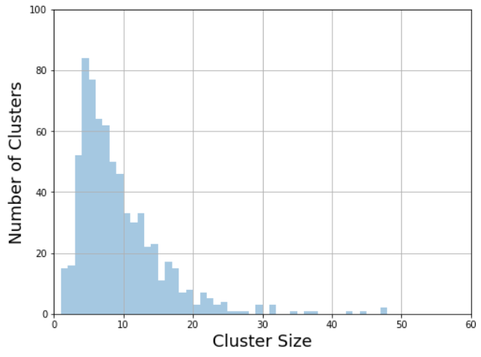
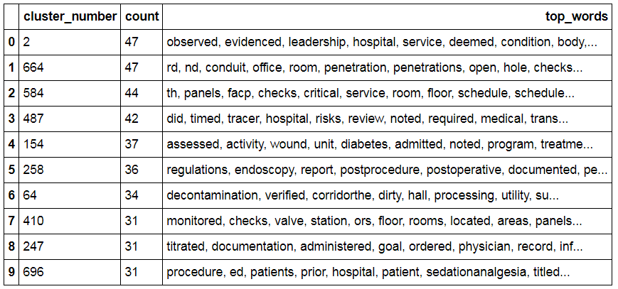
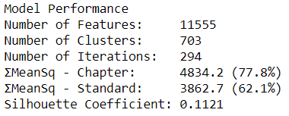
Clustering Model – Version 0
Clustering Technique: AffinityPropagation (Distance = Cosine, Dampening = 0.9, Convergence Iterations = 15)
Feature Engineering: None

Slide 10
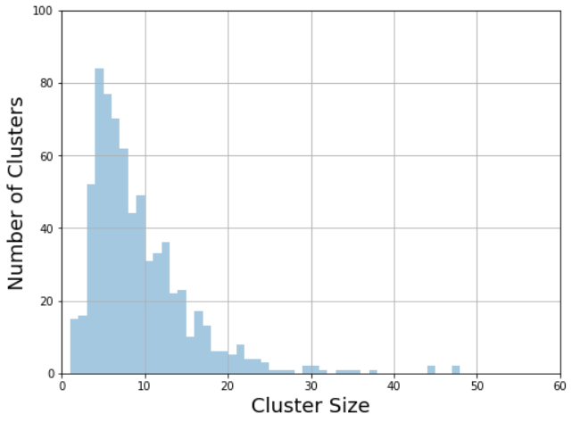
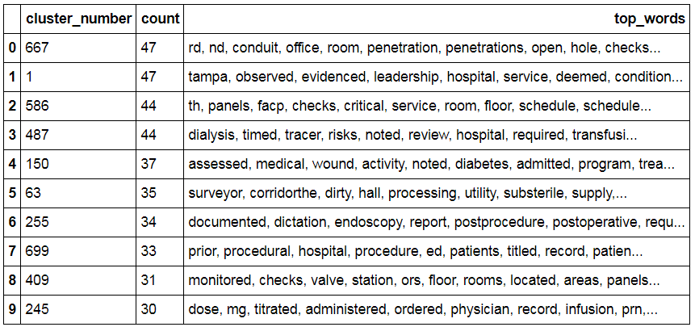
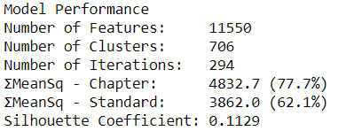
Clustering Model – Version 1
Clustering Technique: AffinityPropagation (Distance = Cosine, Dampening = 0.9, Convergence Iterations = 15)
Feature Engineering: NLTK Stopwords Removed

Slide 11
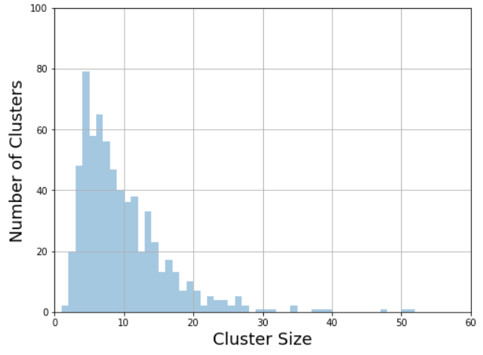
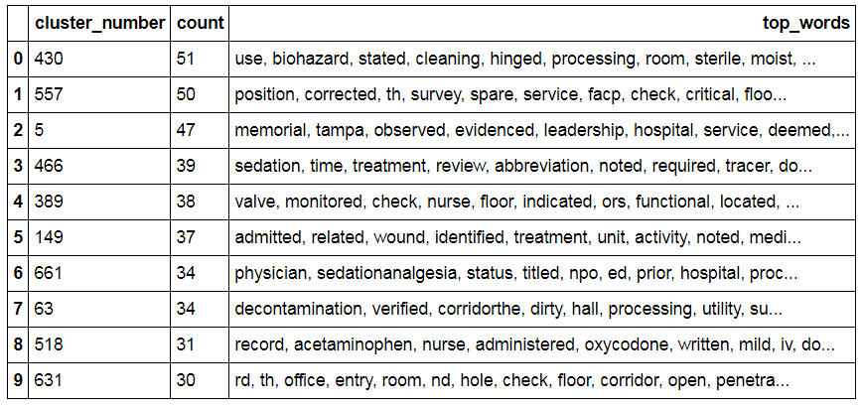
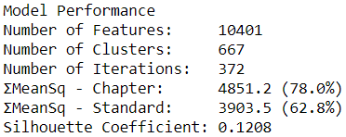
Clustering Model – Version 2
Clustering Technique: AffinityPropagation (Distance = Cosine, Dampening = 0.9, Convergence Iterations = 15)
Feature Engineering: NLTK Stopwords Removed, Limited Plural & Singular Reconciliation

Slide 12
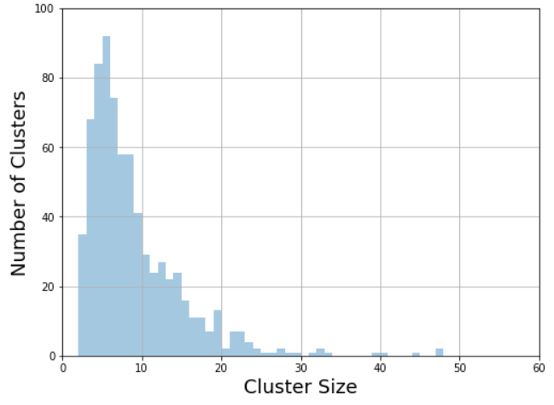
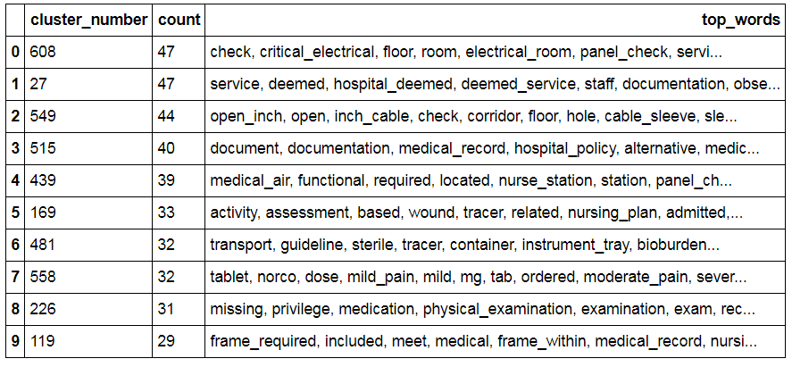
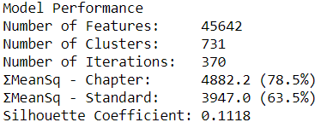
Clustering Model – Version 3
Clustering Technique: AffinityPropagation (Distance = Cosine, Dampening = 0.9, Convergence Iterations = 15)
Feature Engineering: NLTK Stopwords Removed, Limited Plural & Singular Reconciliation, Modified Bi-Gram

Slide 13
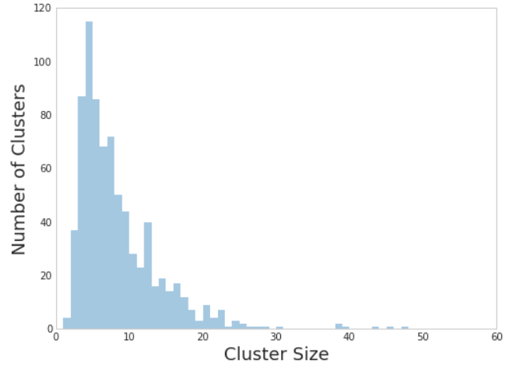
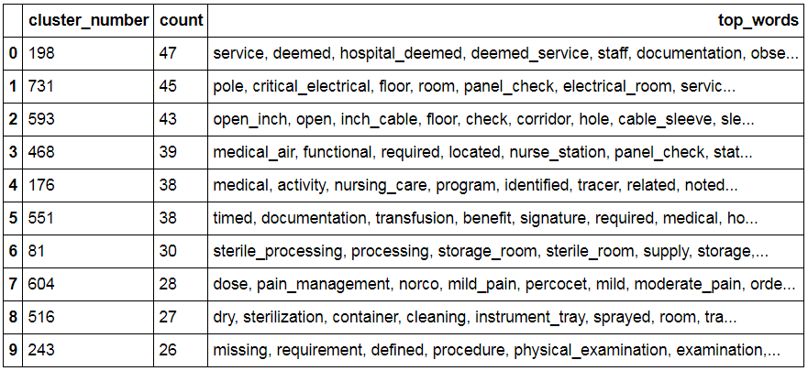
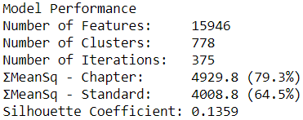
Clustering Model – Version 4 wip
Clustering Technique: AffinityPropagation (Distance = Cosine, Dampening = 0.9, Convergence Iterations = 15)
Feature Engineering: NLTK Stopwords Removed, Limited Plural & Singular Reconciliation, Modified Bi-Gram, TF-IDF(df_min = 2)

Slide 14
The results
Out of 6200+ observations, ~780 clusters
We have a robust model
Clusters appear to be well defined
Clustering is occurring around chapters & codes even though they are not in the data being modeled
Virtually no change when observations are added
Virtually no change when observations are shuffled
Virtually no difference between Cosine & Euclidean approaches
Performance decreases when algorithm is forced to choose fewer clusters
Output plugged into tableau for exploration

Slide 15
Tableau Demonstration

Slide 16
Risk & Considerations
The TJC survey slowly changes over time and surveyors may change. As a result the language that appears in the observations likely change over time. To what extent is unknown.
This approach to unsupervised clustering algorithm seems to be effective, but it may not be scalable in its current form
This is an O(N^2) problem
With 6200+ observations, the clustering algorithm takes 7-10 min
The whole process takes ~20 minutes
The algorithm can be parallelized, but has not been done yet

Slide 17
Above all else, we are committed to the care and improvement of human life.

Slide 18

Appendix – MEAN Silhouette Coefficient
The silhouette value is a measure of how similar an object is to its own cluster (cohesion) compared to other clusters (separation). The silhouette ranges from −1 to +1, where a high value indicates that the object is well matched to its own cluster and poorly matched to neighboring clusters.
The Silhouette Coefficient is calculated using the mean intra-cluster distance (a) and the mean nearest-cluster distance (b) for each sample. To clarify, b is the distance between a sample and the nearest cluster that the sample is not a part of.
Source: https://en.wikipedia.org/wiki/Silhouette_(clustering)
Source: http://scikit-learn.org/stable/modules/generated/sklearn.metrics.silhouette_score.html

Slide 19
Appendix – Sum of the MEAN Squared counts (A)
 | X | Y | Z | Σ
A | 3 | 0 | 0 | 3
B | 0 | 2 | 0 | 2
C | 0 | 1 | 2 | 3
 | X | Y | Z | Σ | ms
A | 9 | 0 | 0 | 3 | 3
B | 0 | 4 | 0 | 2 | 2
C | 0 | 1 | 4 | 3 | 1.66
Σ Mean Sq = 3 + 2+ 1.66 = 6.66

Slide 20
Appendix – Sum of the MEAN Squared counts (B)
 | X | Y | Z | Σ
A | 3 | 0 | 0 | 3
B | 0 | 3 | 0 | 3
C | 0 | 0 | 2 | 2
 | X | Y | Z | Σ | ms
A | 9 | 0 | 0 | 3 | 3
B | 0 | 9 | 0 | 3 | 3
C | 0 | 0 | 2 | 2 | 2
Σ Mean Sq = 3 + 3 + 3 = 8

Slide 21
Appendix – limited plural & singular word reconciling
Words ending in ‘s’
Original Word | Stemmed Word | Matching Word
hospitals | hospital | hospital
licenses | license | license
class | clas | (none)
glasses | glasse | (none)
Look for words ending in ‘s’ and ‘es’
Stem those words
Look for matching words in corpus
Build dictionary of matching words
Not perfect, but useful
Risk: Misspelled words
Words ending in ‘es’
Original Word | Stemmed Word | Matching Word
glasses | glass | glass
nurses | nurs | (none)
glass | glas | (none)

Slide 22
Appendix – Modified Bi-Gram
Use punctuation to limit to bi-gramming
Example: pain scores, medications, vitals, and labs
Original: Remove punctuation and ignore stopwords
pain scores medications vitals X labs
Result: pain_scores, scores_medications, medications_vitals
Modified:
pain scores X medications X vitals X X
Result: pain_scores

